Slide 1
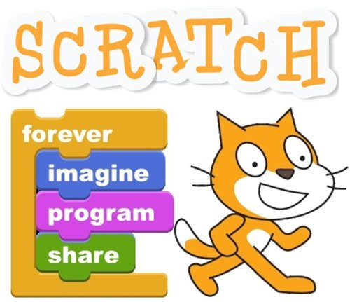
Introduction to Programming using Scratch

Slide 2

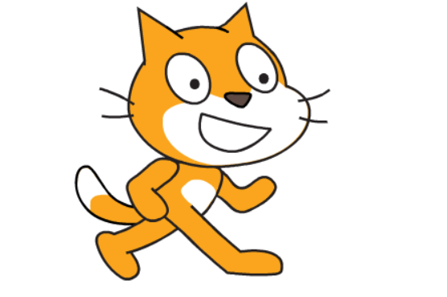
What is Scratch
?

Slide 3
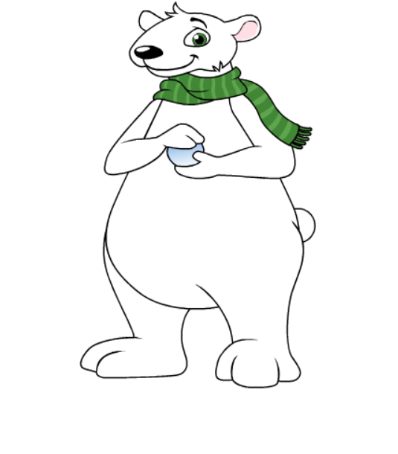
Scratch is Visual Programming Language.

Slide 4
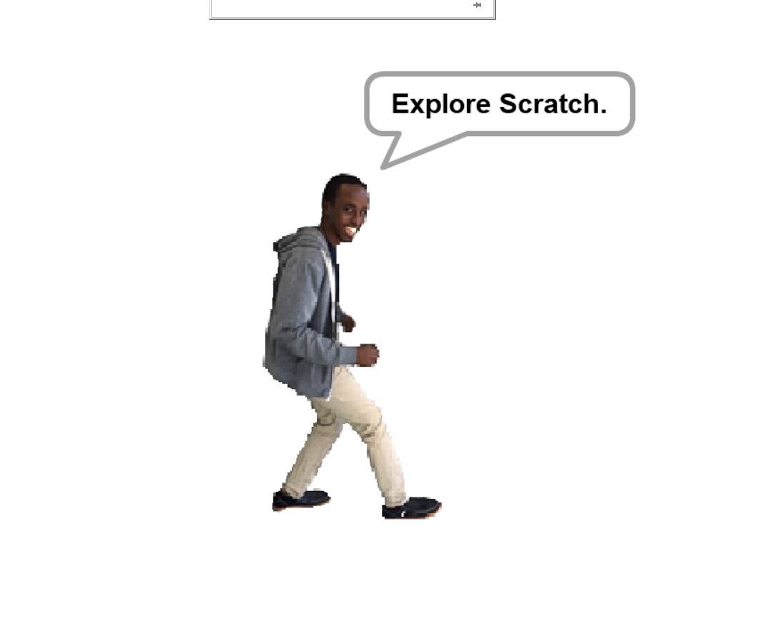

Slide 5
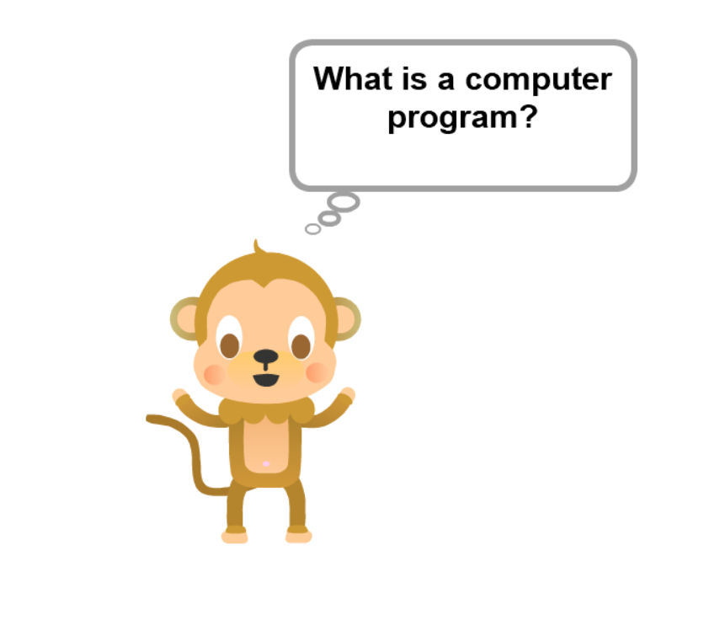

Slide 6
Structure of a program
Entry Point
Statements and Instructions
Program termination

Slide 7
Operators
+ - * / %

Slide 8
Operators
< less than
> greater than
= equal to
and
or
not

Slide 9
Integer
Float
Strings
Boolean (True or False)
List

Slide 10
Constants
and
Variables

Slide 11
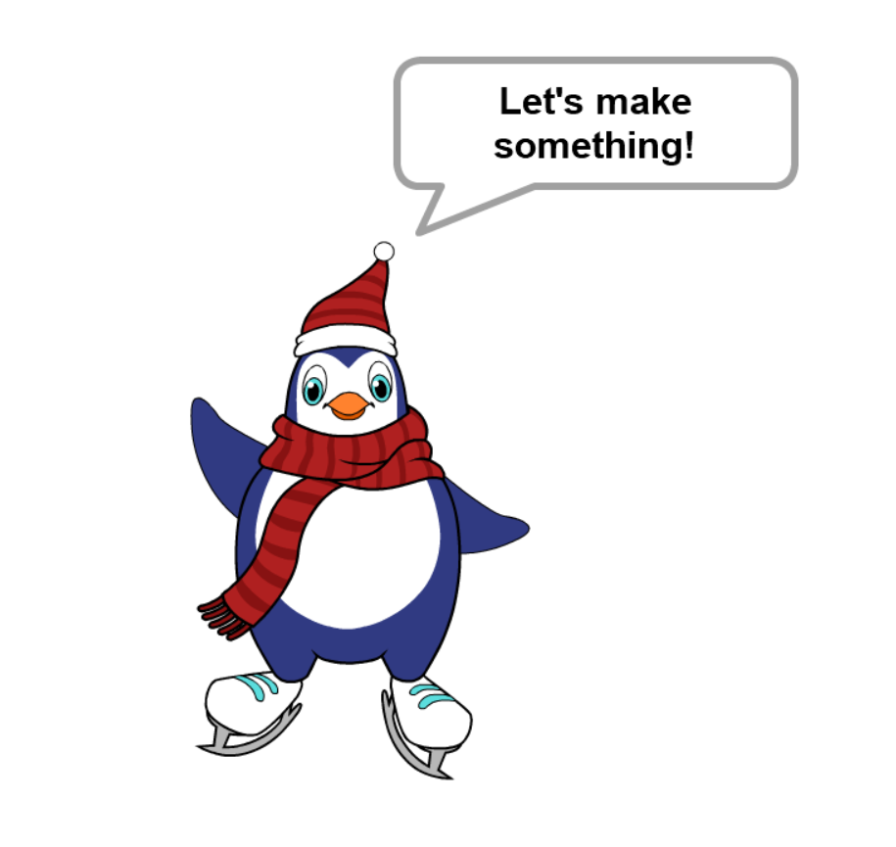

Slide 12
Conditions
if condition then
statement_true
else
statement_false

Slide 13


Slide 14
